Slide 1

Electric Vehicles at Scale in Ireland
Opportunities and Challenges
Thought Leadership
Group 12
28 October 2021

Slide 2


Topic Page
Executive Summary 3
01 Opportunities 4
Introduction 5
Reduced energy cost 6
Emissions Reduction 9
02 Challenges 11
Introduction 12
Infrastructure 13
Battery 15
Cost 16
03 EY Recommendations 17
Appendix 20
Page

Slide 3
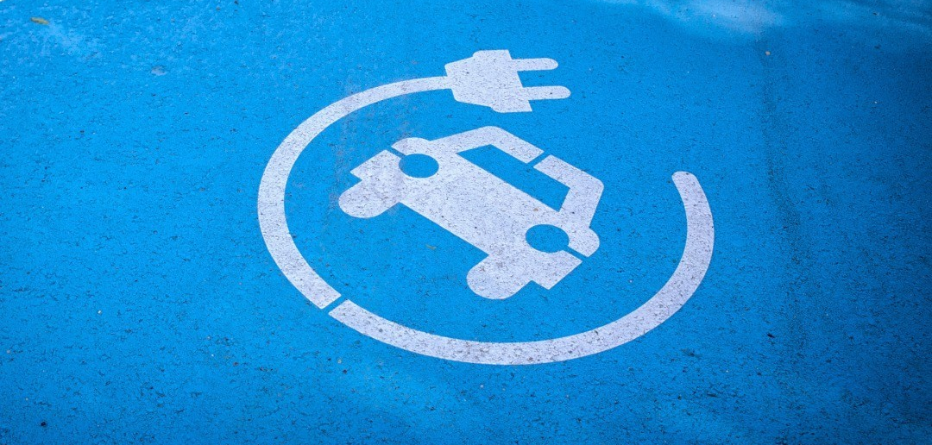
Opportunities: Introduction
Executive
Summary
The following report will investigate the opportunities and challenges for the adoption at scale of Electric Vehicles (EVs) in Ireland. The aim of the report is to outline how EY can improve its consulting offering to the Electric Vehicle sector
The report is divided into three distinct sections
Opportunities
Challenges
EY Recommendations
The first section outlines the opportunities for the adoption of Electric Vehicles in Ireland. It examines, decarbonisation and the opportunities for data companies.
The second section deals with the challenges for Electric Vehicles in Ireland. It investigates the consumer concerns over battery range and performance, the relatively high costs associated with purchasing an EV and the potential impact of increased charging on the Irish electricity network. The third and final section outlines our recommendations to EY when consulting the EV sector.
Climate change is a challenge that will require a wide range of mitigation measures to reduce just the short term impacts. The use of fossil fuels as our primary source of energy supply is clearly one of, if not the biggest, influences on what the long term impacts of climate change will be. With the developing nations’ economies growing rapidly it is clear that the global use of energy will increase greatly. This will not only have implications for climate change.
The increasing use of fossil fuel, a finite resource, will ultimately result in increasing costs of energy use. It has been shown how dependent transport is on fossil fuel use and that transport is one of the biggest sources of GHG emissions globally and locally. Transport is also one of 40 the most important sectors of every economy and increasing costs for this sector will continue as long as its fossil fuel dependency continues. Alternative technologies are now becoming available to begin to make this movement away from fossil fuel. Electric vehicles presently provide the lowest emission option, if not zero emissions, for the foreseeable future
Ireland, and its transport sector, is completely dependent on the import and use of fossil fuels for its energy supply. The Irish government, and transport sector, have a golden opportunity to become one of the leading locations in the world for use of electric vehicles. This will help to address both our commitments to tackling climate change and improving our energy independence. It will also benefit the Irish economy by increasing use of domestically produced energy in the transport sector energy. It would also benefit Irish consumers by reducing their transport energy costs and protecting them from rising international fossil fuel prices. Irish consumers will have a central role in whether or not the electric vehicle can succeed here. It is important to know what they want and what their attitudes are as the new market for EVs is developed here in Ireland

Slide 4
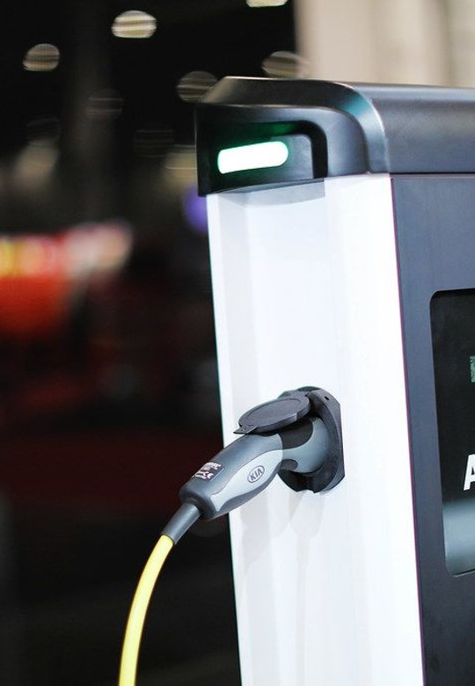
“Electric vehicles are not going to take the market by storm, but it is going to be gradual improvement”
- Carlos Ghosn
01 Opportunities
01 02 03
“

Slide 5

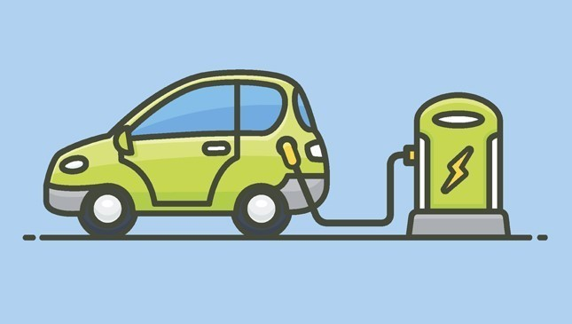
Opportunities: Introduction
1
  1. Reduced energy cost and Vehicle service cost
Electric car technology has advanced significantly in recent years. Driving ranges have increased, charging infrastructure has expanded, and car costs have decreased.
Switching your company's fleet to electric cars will help you minimize your carbon footprint, which will increase over time as more renewable energy enters the system.
Electric cars offer cheaper operating and maintenance expenses than their gasoline and diesel counterparts. With a variety of incentives available to individuals who purchase electric vehicles, now is an ideal opportunity to examine the changes.
Because of technological advancements, rising market penetration, and the availability of information, it is now simpler than ever to analyse the feasibility of electric cars for your business fleet.
Reduced energy cost
For many fleet managers, the rising cost of fuel is a significant challenge. Many of those operating fleets see the cost of fuel as a significant factor when trying to maintain a competitive edge. While combustion engines have become somewhat more efficient, even these gains do little to combat the upward trend and uncertainty of fuel prices. Electric vehicles offer an opportunity to make cost and energy savings.
Fuel consumption varies from vehicle to vehicle as well as from driver to driver. Studies show that the running costs of an electric vehicle can be as little as 20% of the cost of a similar size diesel engine (Green eMotion, 2015). Recharging of vehicles on night-rate electricity tariffs, with electricity rates close to half of a standard daytime rate, ensures you maximise the savings.
Most of the electric vehicle charging occurs at night. During this time, the cost and carbon intensity of the electricity supply is generally at its lowest.

Slide 6
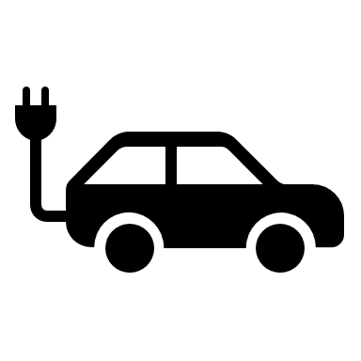
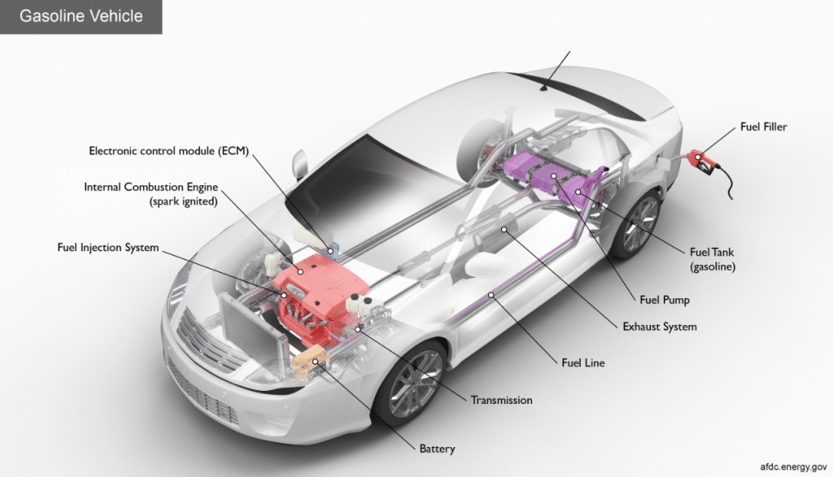
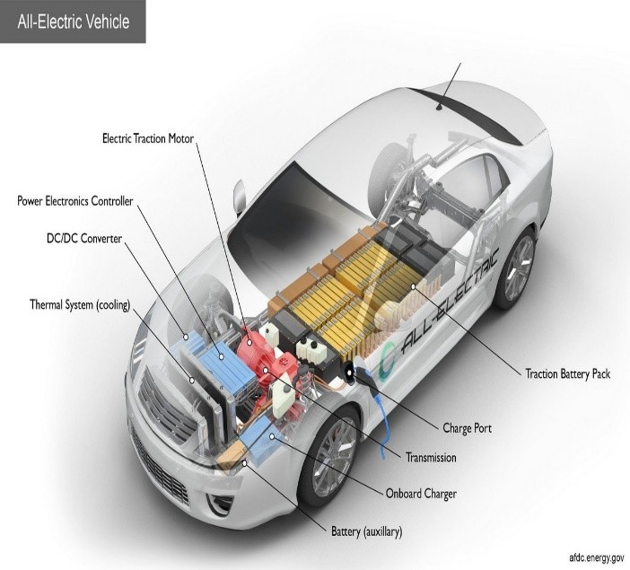
Opportunities
01 02 03
    51%
    Of the energy cost is saved by
    the electric vehicle as
    compared to the
    typical diesel car
    The cost of the diesel to travel for 100 KM approximately around €8.16 and the cost of the electric vehicle to travel 100km is approximately €4.16
    Reduced vehicle service cost:
    Electric vehicles have lower service costs than vehicles with combustion engines. Battery Electric vehicles have far fewer moving parts than internal combustion engines and do not require timing belts, fuel filters, or engine oil to replace. The regenerative braking system reduces brake pad wear by using the motor as a generator when the brake is applied. As a result, the required friction brakes are very low compared to vehicles with internal combustion engines. It is not uncommon for EVs over 100,000 km to use original brake pads.
    This is especially good news when the vehicle is used in urban areas where the brake pads wear quickly.
In figure 1, it is the comparison in the maintenance cost between the gasoline/diesel vehicle and electric vehicle.
Figure 1: Maintenance in internal combustion engine and electric vehicles

Slide 7
Opportunities
01 02 03
The table depicts the maintenance checklist between the battery electric vehicles and internal combustion engine.
Service parts
Battery electric
Internal
vehicle
combustion
engine
Each oil change can
Engine oil
None
Yes
take between four and
six litres of oil
Oil filter
None
Yes
Fuel filter
None
Yes
Spark plugs
None
Yes
Air filter (engine)
None
Yes
Pollen filter
Yes
Yes
Very low wear on
Brake fluid
Yes
Yes
electric vehicle due to
regenerative braking
Coolant
None
Yes
AdBlue
None
Yes
Brake pads
Yes
Yes
Brake disks
Yes
Yes
Tyres
Yes
Yes
Driving in eco mode
reduces tyre wear
Table 2: Vehicle maintenance checklist comparison

Slide 8
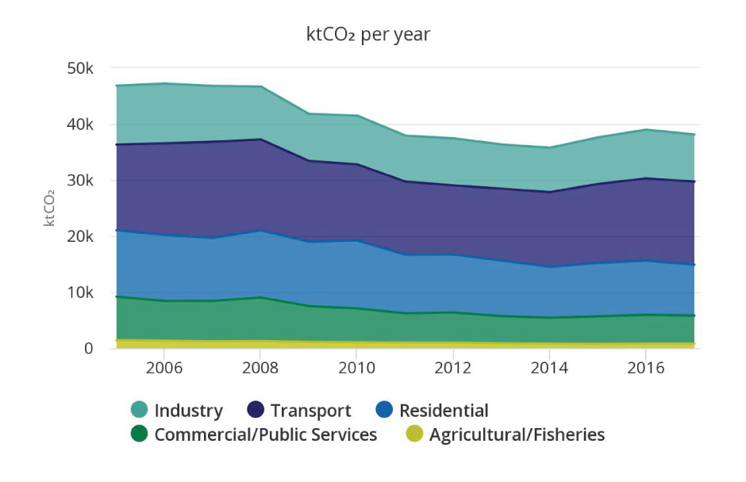
Opportunities
01 02 03
  2. Emissions reduction
2.1 Improve air quality
In Ireland, transport dominates as the largest energy consuming sector, accounting for 42% of energy related greenhouse gas emissions
Switching For the average new car purchased, CO2 emissions per kilometre fell by 32% between 2007 and 2017, reaching 112.0 g CO2/km in 2017. This was due to car taxation changes, and EU obligations for manufacturers to reduce fleet emissions.
In 2018 the average CO2 emissions per kilometre increased again by 1%. This was the first increase since 2007 and is partly due to the increasing share of SUVs.
Because of technological advancements, rising market penetration, and the availability of information, it is now simpler than ever to analyse the feasibility of electric cars for your business fleet.
In addition to carbon dioxide, combustion engine vehicles generate other tailpipe emissions that are harmful to human health, including particulate matter, nitrogen oxides, sulphur oxides, volatile organic compounds, and ozone.
It is often stated that electric vehicles are not 'zero emissions'. This is true, instead they have zero tailpipe emissions. However, there are two important points to consider.
The emissions per km from driving electric is far less than driving petrol or diesel. This is true even when you consider the emissions from the power station. EVs remove emissions from the air, saving pedestrians and cyclists from breathing in the dangerous

Slide 9
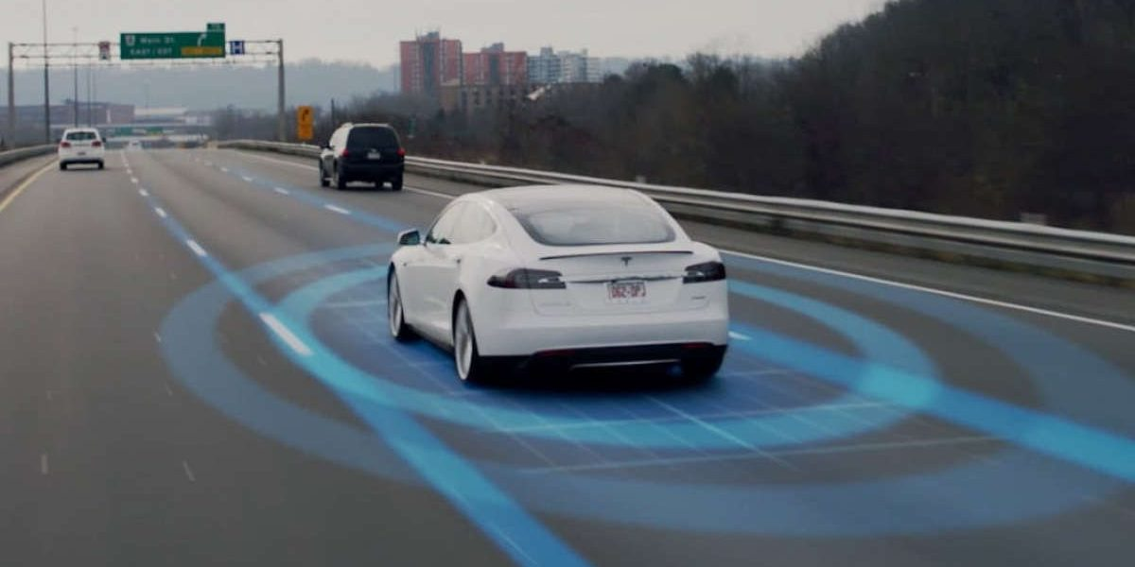
Opportunities
01 02 03
    The elimination of tailpipe emissions has a direct effect on our air quality. Even when emissions from Irish electricity generation are considered, the CO2 emissions from EVs are less than those from the cleanest petrol engines
    Switching to electric vehicles can help to decarbonise its transport-related energy emissions, unlocking improvements in environmental performance year-on-year as more renewable sources of electricity come online.
    2.2 Reduce noise
While we don’t always consider noise as a pollutant, it impacts greatly on quality of life, particularly in cities. Noise pollution has adverse impacts on the well-being of human life and affects the health and distribution of wildlife (EEA, 2014). As with most vehicles, the noise we hear at speeds above approximately 40kph is generally road noise from the tyres
The European Union is committed to reducing pollution across the member states and noise pollution forms a part of this strategy, as stated in the Environment Action Programme “Living within our limits”.
The decibel reduction targets are tough. In 2023 only 70% of today’s cars will meet the new standards. That will decrease further to only 30% in 2027. Buses and trucks fall under this legislation too, everything on EU roads will have to become quieter in the coming decade.
The relative quietness of an electric vehicle allows a reduction in the noise levels around us. Elimination of engine noise makes our environment a lot more peaceful. But just in case you are worried that EV's are too quiet, for safety reasons EV's do emit a sound when travelling at low speed.
Electric Vehicle | Petrol Engine
CO2 60g/km | CO2 130g/km

Slide 10
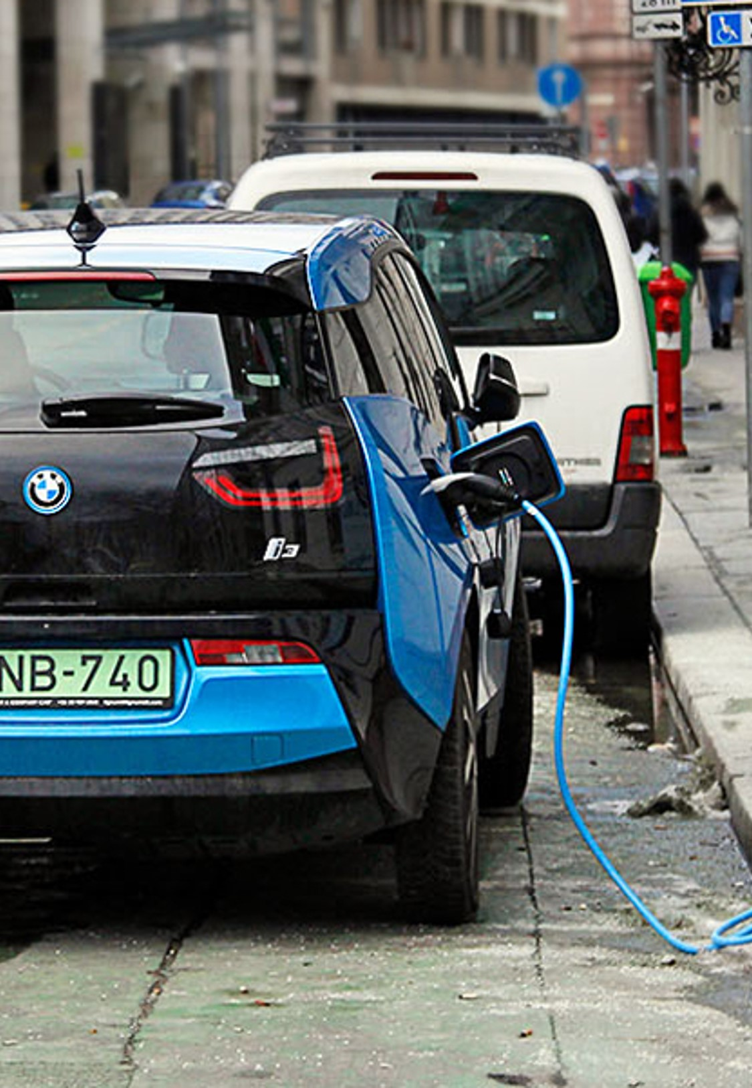
“Nobody wants to buy a $60,000 electric civic. But people will pay $90,000 for an electric sports car.”
- Elon Musk
02 Challenges
01 02 03
“

Slide 11
2
1
2
Challenges
  A recent report suggests the biggest challenges in embracing electric vehicles for the customer currently are the cost and the charging experience, finding that negative charging experiences made customers wary and sceptical about moving to fully electric technology. A range of infrastructure upgrades and purchase incentives may be needed in order to counteract the reluctance to move away from traditional combustion engines.
  1. Infrastructure
In Ireland, there are only 40 chargers per 100k of population which is considerably lower than 60 per 100k in France and 350 per 100k in Norway. Achtnicht et al. (2012) and Tran et al. (2013) recognise that a lack of charging availability slows down EV uptake. In a study of charging infrastructure and socio-economic characteristics in EV adoption across 30 countries, charging infrastructure appears to be the best predictor of a country’s EV market share. With EVs making up 12% of new car sales from January to May, the main question shifts to the availability of adequate charging points to meet growing demand.
Essentially, if the battery is fully discharged without access to a charging point, the driver will be stuck wherever they may be, highlighting the necessity of a sufficient nationwide network of readily-accessible charging points or for EV owners to install a home charging point. To overcome this situation AA has introduced the mobile Electric Car Charging Unit. On average, the AA will be able to provide an electric vehicle with approximately 15% of battery charge in just 20 minutes, allowing the motorist to then proceed to the nearest charging point. That brings us to a rough total of 1,800 generally available charging points, plus a smattering of privately held ones, plus the 34 Telsa Superchargers. Let’s say 2,000 individual points, give or take.
To overcome this situation AA has introduced the mobile Electric Car Charging Unit. On average, the AA will be able to provide an electric vehicle with approximately 15% of battery charge in just 20 minutes, allowing the motorist to then proceed to the nearest charging point. That brings us to a rough total of 1,800 generally available charging points, plus a smattering of privately held ones, plus the 34 Telsa Superchargers. Let’s say 2,000 individual points, give or take.

Slide 12
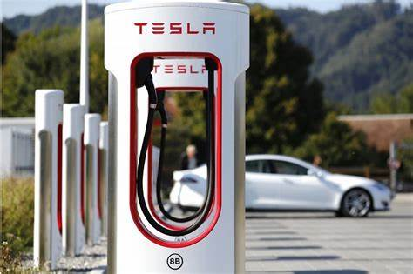
Challenges
01 02 03
More than 6,000 new electric cars have been sold in Ireland so far this year(2021). OK, so not all of them are going to need public charging all at once, but anyone who’s tried to take an electric car on a long-ish journey around Ireland will be able to tell you that queues and waiting times have begun to stretch out.
    A glance at a map of charging points pretty quickly tells you that you will find the densest clusters of them in the Dublin region (which is hardly a surprise) but rapid chargers – those that can charge at 100kW speeds and above, which with the rising capacity of car batteries should be considered something of a necessity – are really quite hard to find once you’re outside the Pale. So, the further away you get from Dublin, the longer the queue, and the longer you’ll have to spend charging to get a decent top-up.
    Actually, on a per-capita basis, we’re not doing too bad, with around 40 chargers per 100,000 population – assuming you include Tesla Superchargers. That compares well with the UK average of 27 per 100,000 but that UK figure is skewed heavily by the figures for London, which has 57 public chargers for every 100,000 inhabitants. In France, the figure is closer to 69 per 100,000 population, on average, while in Norway it’s a whopping 350 chargers per 100,000 population.
    According to environmental think-tank Transport & Environment (T&E), we’re going to need many, many more charging points if we want to get people out of their petrol and diesel cars and into EVs. T&E’s research shows that the EU will need 2.9 million public charging points by 2030, and Ireland will need close to 30,000 if the goals of decarbonising the transport system are to be met.
    We are way behind. More new DC chargers go live every month in the UK than exist overall in Ireland” Gerry Cash, from private charging point provider EasyGo told The Irish Times.
    “We need to improve and support EV adoption to replace internal combustion vehicles. EV sales this year to date already exceed the whole of 2019, as per SIMI’s latest numbers, despite the fact that we are still coming out of Covid.
    A glance at one of the problems, according to Cash, is actually one that was originally touted as an advantage for Ireland in setting up an EV ecosystem – the fact that the main energy supplier, the ESB, is partly state-owned.
    “It is a little odd that Ireland, uniquely in Europe, has a state-owned distribution system monopoly, ESB Networks with an affiliate sate-owned company ESB eCars that is intending to roll out public chargers, using this very same distribution system. EU Directive 2019/944 specifically states that distribution system operators are not allowed to own, develop, manage or operate such EV chargers other than for their own use and a level playing field must apply for all market participants.”

Slide 13

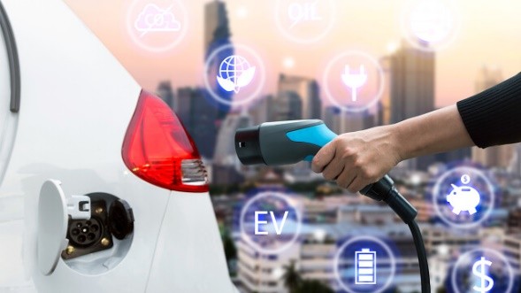
Challenges
01 02 03
That can lead to enormous frustration for the end-user, and that is ultimately what a public charging network is all about – if most people, as is expected, do most of their charging at home, then the primary job of the public network is to convince people that when they do need to take a longer journey, they will be able to easily and conveniently get a charge, where and when they need to. The Government has recently come in for criticism for a big announcement of new charging points being rolled out, which actually only included an additional 29 points – around a one per cent increase in charging locations. ESB has recently opened its first eight-bay rapid charging hub – featuring six 350kW connectors, and two 50kW hook-ups, at Mayfield in Co Kildare, just off the M7 motorway.
Marguerite Sayers, executive director, customer solutions at ESB, said: “The electrification of transport is a key component of ESB’s low carbon strategy for a brighter future. The first eight vehicle high power EV charging hub is a significant milestone as we work to meet the growing number of EVs on Ireland’s roads. This new 350kW high power charging hub, as part of our overall upgrade works, will significantly reduce charging time for EV users.
When you couple this with at-home charging, it really signifies a positive next step for current and future EV drivers in Ireland.” It won’t have escaped your notice that this latest roll-out is once again rather Dublin-centric, but ESB said that it has plans for 50 similar rapid-charge hubs, so other areas of the country should eventually benefit from one.
At least one part of the charging ecosystem does seem to be, ahem, charging forward – home plug points. According to Robert Cazaciuc, programme executive for EV charging infrastructure at the Sustainable Energy Authority of Ireland (SEAI), grant applications for home chargers – so crucial to efficient EV use – are racing ahead.
  2. Battery
Encountered with new, unfamiliar product, research has shown that consumers worry and perceive high risks and are consequently slow in the adoption process One of the key barriers for EV adoption in Ireland is consumers' concern of limited driving range i.e. the maximum distance they can travel with a fully recharged battery. Termed “range anxiety”, it is defined as fear, worries, and stress caused by concerns over being stranded in the middle of a trip due to depleted battery before reaching recharging station. (Rau et al 2015)

Slide 14
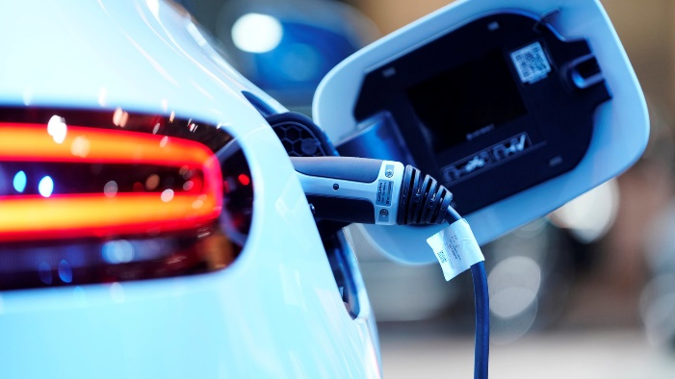
Challenges
01 02 03
Charging a car on a standard chargers(up to 22kwH) could take anything from an hour to 7 hours to charge to 80% , depending on the type of car and battery size. For example – a 2016 Nissan LEAF can only take 3.6kW speeds from these points – which equates to around 30km of driving per hour charging. However, some cars such as the Tesla Model S and the Renault Zoe can take the full 22kW, enough to cover 150km in most cases
There are rapid developments in battery and charging technology, but this is causing deep uncertainty. Which charging technologies will become the gold standard?
This is a particular problem for people living in apartment blocks, or houses without a private parking space. Should they expect charging to be available at bollards or lamp posts along their street?
The question also remains: how large should the government's contribution be in future infrastructure development?
3. Costs
Despite incentives and grants available for purchasing and installing charging points for consumers, entry into the electric vehicle for market for many is difficult due to the high initial purchase price and lack of second hand vehicles
    With entry-level costs north of €25,000, it’s a significant investment to consider – from around 15 to 50% more expensive than petrol and diesel equivalents.
    “There is an interesting question whether the Irish government EV target is realistic”
    Sadhbh O’Neill, UCD lecturer in environmental politics and a policy advisor
We’ve seen a drastic fall in the cost of lithium-ion batteries in recent years down 97 per cent in three decades. But at the moment, the upfront cost of a new electric car is still more expensive than a new petrol or diesel car, and the second-hand market is in its infancy.
    There is more choice for those looking for a new car, but electric vehicles are disproportionately aimed at the higher end of the market. Prices are likely to continue to fall and operating an electric vehicle tends to be cheaper than a petrol or diesel equivalent. But the higher upfront costs may stop many drivers from buying electric vehicles for the foreseeable future, even when a vibrant second-hand market emerges.
    The goal of 950,000 electric vehicles on Irish roads by 2030 is seen by experts as a big, if not impossible, challenge. “There is an interesting question whether their EV target is realistic,” said Sadhbh O’Neill, a UCD lecturer in environmental politics and a policy advisor.
On top of this, the Department of Expenditure and Reform earlier this month issued a warning to government that increasing numbers of electric vehicles “could pose a substantial risk to the stability of the State’s finances”.
The department warned that the growth projection of electric vehicles will result in over 1.5 billion less revenue from motor VAT and fuel oil tax during the 2020s. And because fuel tax is an important source of income for the government - and electric vehicle users pay lower taxes - changes to the tax system may be required.

Slide 15
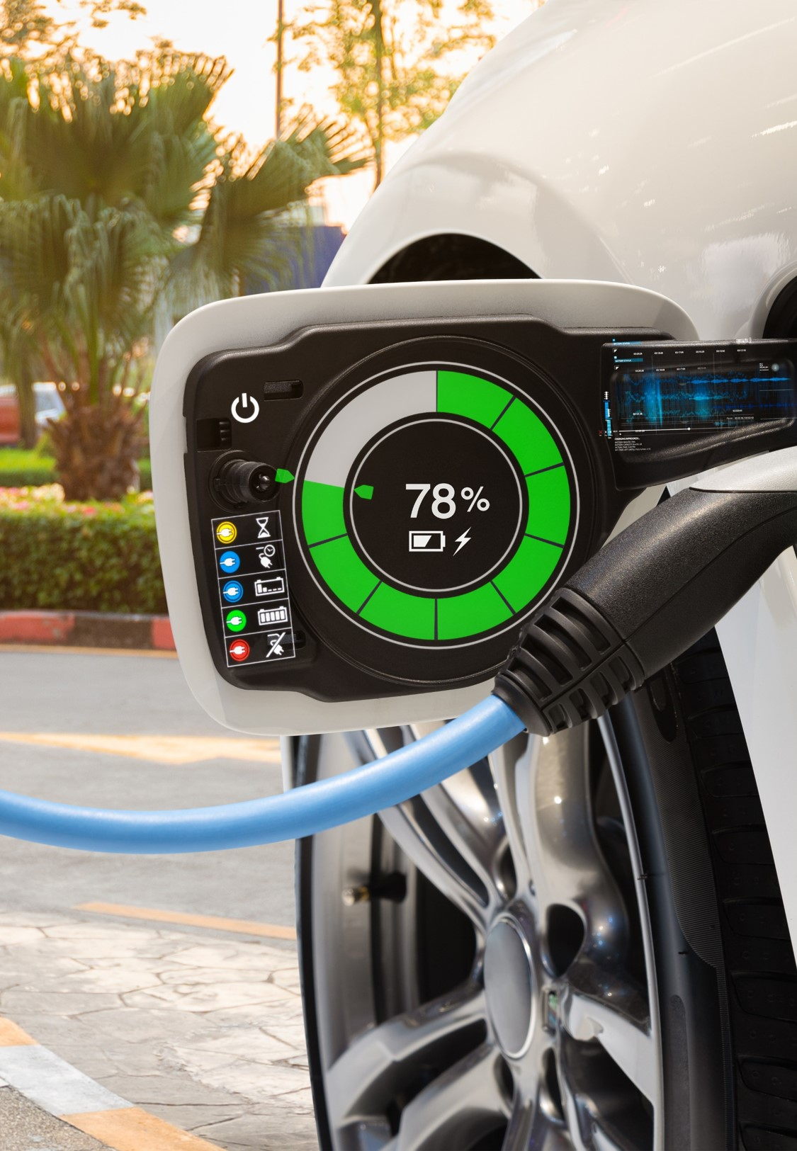
Electric Vehicles aren’t pollution-free; they have to get their energy from somewhere.
- Alexandra Paul
03 EY
Recommendations
01 02 03
“

Slide 16
EY Recommendations
01 02 03
    Recommendations for EY
    Based on our research we believe that following recommendations could help to adopt Electric vehicles.
EY should collaborate with Irish government and EasyGo charging station vendor, in order to install more charging stations to meet the demand of electric vehicles in Ireland. ESB has 70% of charging stations but also they is an need to encourage private charging vendors to install the stations in Irish market.
As we said in the research it looks like people are interested to buy EV’s more than we expected. More than 6000 new EV’s are being sold in first half of the year already.
People are afraid to buy EV’s mostly because of infrastructure, In general there are long waiting queues to charge the cars on the motorways especially on summers and long weekends. To overcome this situation below are few recommendations
1. Encourage private charging station vendors to install the equipment.
2. To meet the demand on summers, they is a need to get more mobile charging vehicles.
Local government or ESB should think about the temporary charging stations, which should be portable, easy to plugin etc,. These portable charging stations can be used on busy days like long weekends, Fridays or in summer to avoid long queues.
It's possibly an opportunity for EY to liaise with govt/other companies over possibility of changing tax regulations - Irish govt going to have to get back their money somehow. Whether that is through increased green energy consumption/extra push in that area, changing tax etc
Could be lowering the corporation tax again to encourage big corps to move back to Dublin especially post Brexit

Slide 17






Contributors
Team Members
 | Abhishek Danalakota Consultant TC, Microsoft Abhishek.Danalakota@ie.ey.com |  | Connor Gaston Consultant TC, TSD conor.gaston@ie.ey.com
 | Ganesh Musandi Consultant TC, D&ET ganesh.musandi@ie.ey.com |  | Ghassen Soulmi Consultant TC, D&ET ghassen.soulmi@ie.ey.com
Project Manager
Team Sponsor
 | Emma Bourke Senior Consultant PI ITA emma.bourke@ie.ey.com |  | Chris Stanhope Senior Manager TC, TSD Chris.stanhope@ie.ey.com

Slide 18
References
Appendix
“
How Much Does it Cost to Charge an Electric Car in Ireland ? - Money Guide Ireland
https://www.bordgaisenergy.ie/home/ev-charger?utm_source=facebook&utm_medium=social&utm_campaign=sustainability_article_7&utm_term=ev_chargers&utm_content=link_post
Irish EV Owners Association – IEVOA – For Electric Vehicle Owners & Drivers in Ireland
https://esb.ie/ecars/charge-point-map
https://esb.ie/ecars/our-network
Electric Cars in Ireland - Some Facts and Figures - Money Guide Ireland
https://www.seai.ie/publications/EVs-for-Business.pdf

